Slide 1
Analysis of A Model For Social Networks
Weichun Xu
Harinath T Prabhakaran

Slide 2
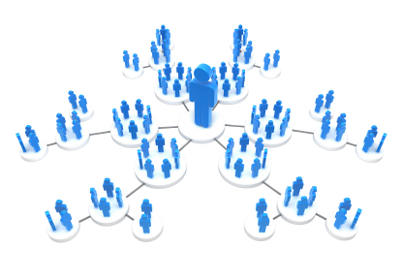
What is social network?
Social Networks is the Economic, political and Social interaction between people forming relationships
Interaction between Relatives, Friends, etc.
Sharing thoughts, risks, views on regular basis
Getting influenced by people who are connected with
Can be of various sizes and shapes depending on random network formation, preferential attachment, etc.

Slide 3

Benefits of analyzing social networks
Could detect the spread of information, disease , influence, etc.
Learn people and suggest them related search. E.g: Google, Facebook, etc.
Impact on social networks on social and economic outcomes. E.g: I Phone bought by reference from a friend, voting, decision making, etc.

Slide 4

Simulation Interface
Project contents
Algorithm of the Model
Implementation of the Model
Vertex Degree Distribution
Clustering Spectrum
Average Nearest-Neighbor Degree
Average Shortest Path Lengths
Average Number of k-clique-communities

Slide 5
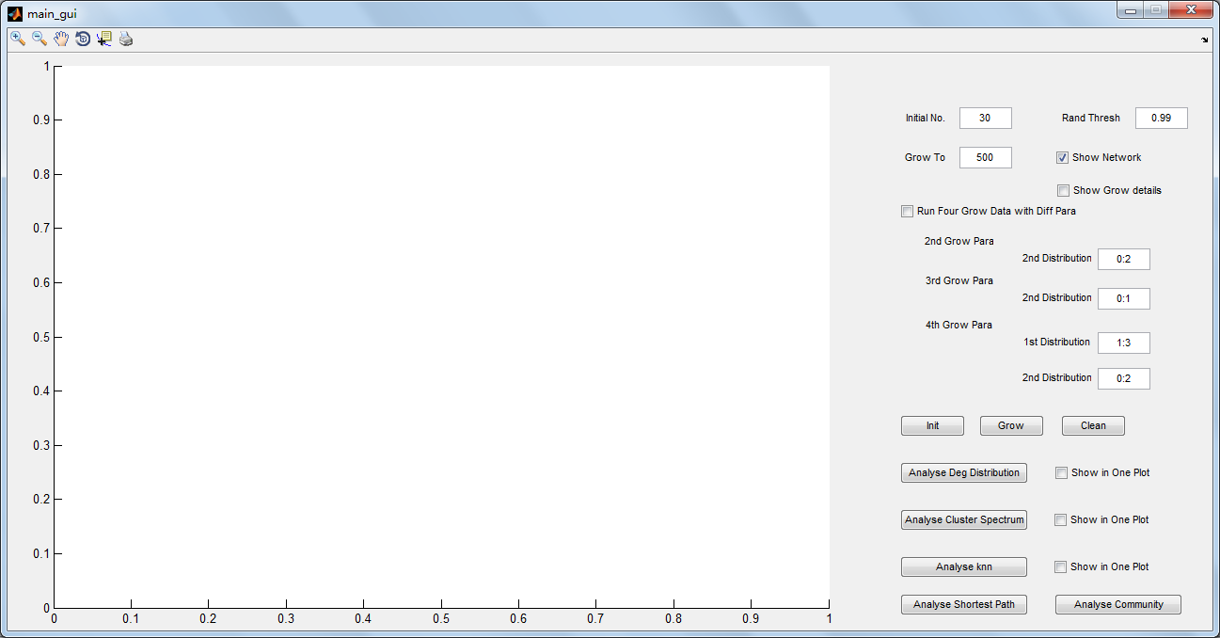
Simulation Interface
Ease of use
User – Friendly
More clarity in presentation

Slide 6


Start with a seed network of N₀ vertices – Where N₀ represents the no of initial nodes (vertices)
Algorithm of the model
pick on average mr $≥$ 1 random vertices as initial contacts
pick on average ms $≥$ 0 neighbors of each initial contact as secondary contacts
Connect the new vertex to the initial and then to its secondary contacts
Repeat steps 2–4 until the network has grown to desired size

Slide 7

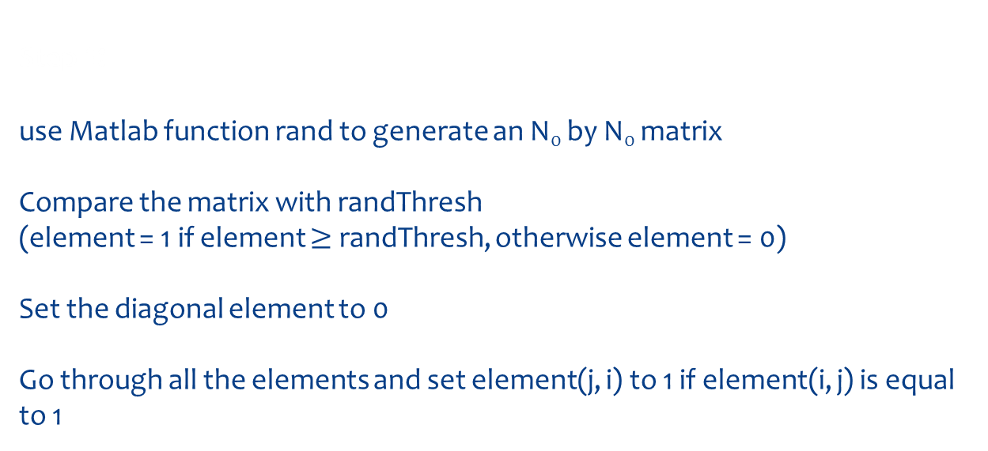
Step 1: use Matlab function rand to generate an N₀ by N₀ matrix Compare the matrix with randThresh (element = 1 if element $≥$ randThresh, otherwise element = 0) Set the diagonal element to 0 Go through all the elements and set element(j, i) to 1 if element(i, j) is equal to 1
Implementation of the Model

Slide 8
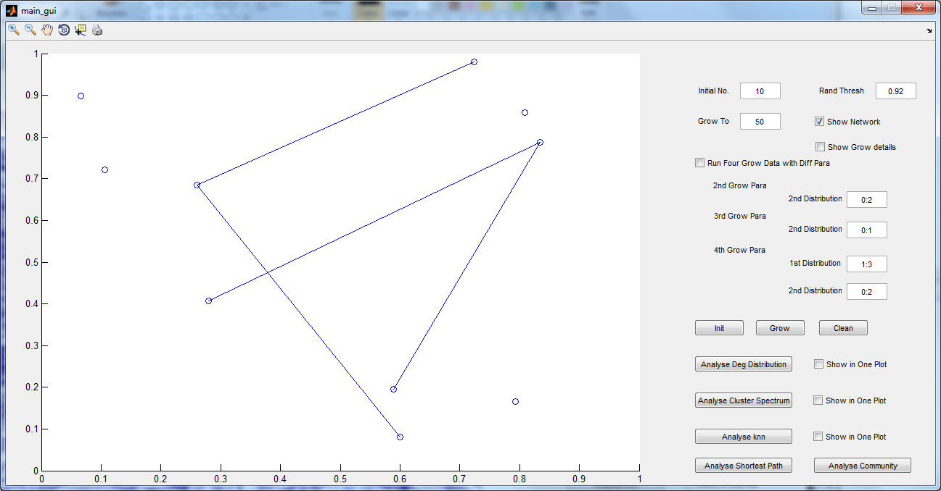
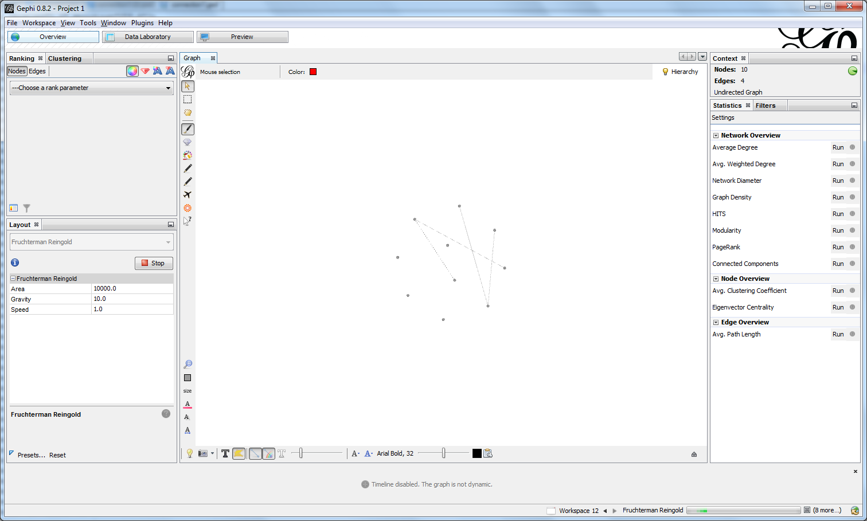
Initialization of the random Model with 10 vertices
MatLab – Plot representation.
Gephi (Network tool)

Slide 9
Implementation of the Model
Step 2: For a new vertices to join a network Generate the number of first contacts based on the probability matrix m_{r}
Randomly pick up the first contact from the existing vertices
Algorithm is coded in such a way that the new vertices forms links with one or more existing networks with the mentioned probabilities

Slide 10
Implementation of the Model
Step 3: For each of the initial contact, generate a random number of the secondary contacts based on probability matrix m_{s}
Method
Get a list of neighbors of the initial contact Eliminate the first contact and the secondary contact that is already chosen Now randomly pick up secondary contacts

Slide 11
Step 4: Connect the new vertices with first contacts and second contacts
Implementation of the Model
Step 5: Check if the network has grown to the required size, otherwise again repeat step 2~4 until it reaches its full growth

Slide 12
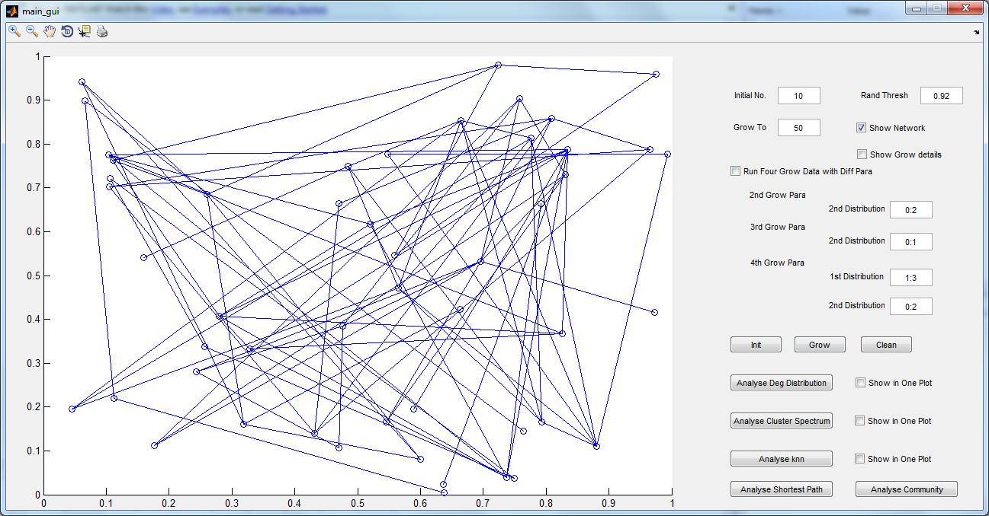
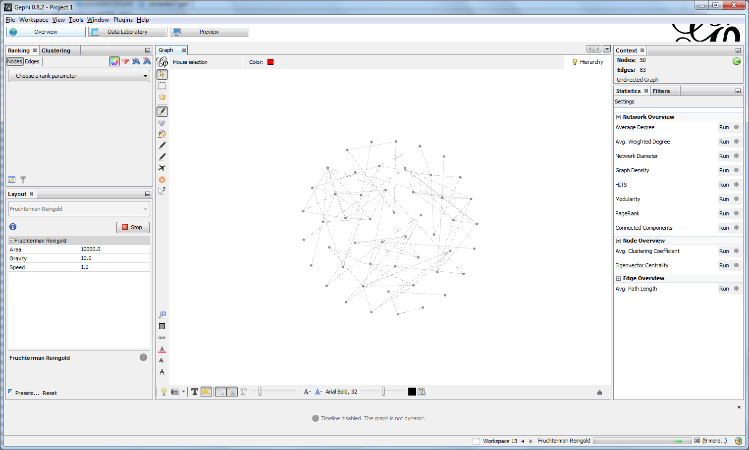
Fully grown network with 50 vertices
MatLab – Plot representation.
Gephi (Network tool) – Representation of a
Fully grown network

Slide 13
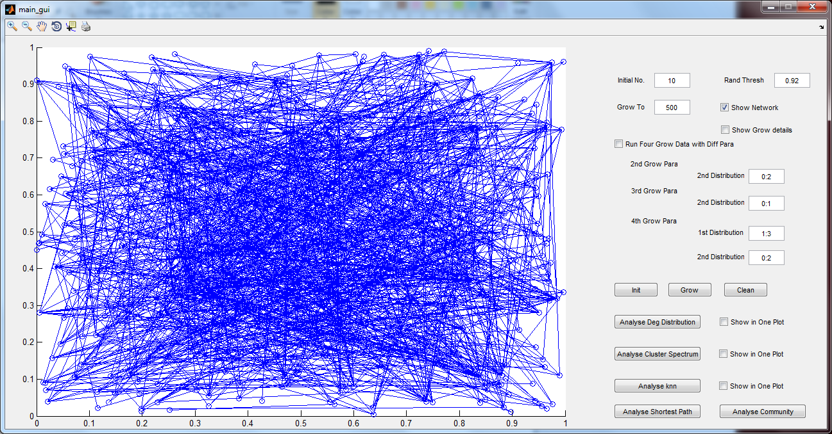
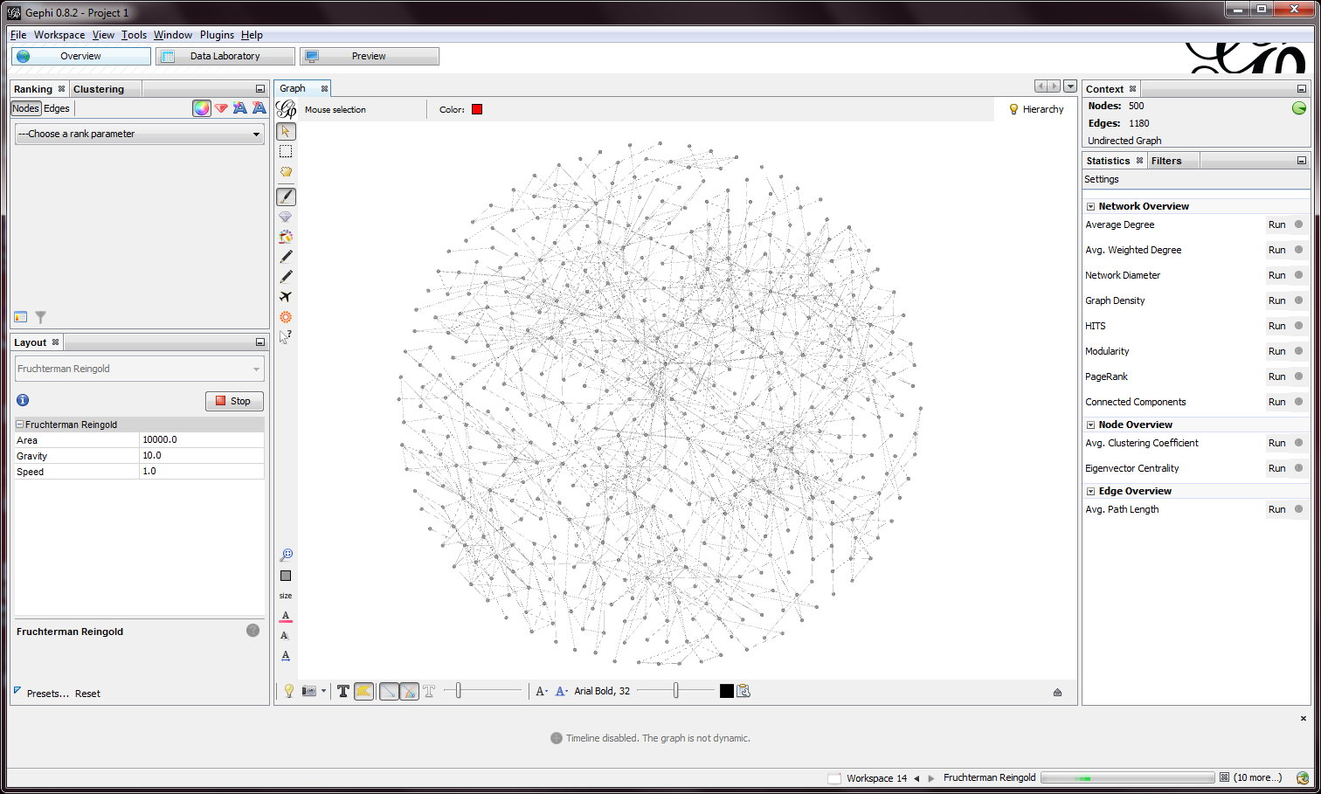
Fully grown network model with 500 vertices
MatLab – Plot representation.
Gephi (Network tool) – Representation of a
Fully grown network with 0 isolated nodes.

Slide 14
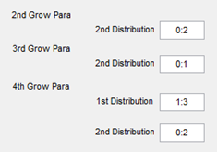

Four networks with different distribution are generated in the simulation: Network1: m_{r} = $\left[\begin{matrix}\text{1} & \text{2} \\ \text{0.95} & 0.05\end{matrix}\right]$ m_{s} = $\left[\begin{matrix}\text{0} & \text{1} & \text{2} \\ 0.25 & 0.25 & 0.25\end{matrix} \begin{matrix}\text{3} \\ 0.25\end{matrix}\right]$ Network2: m_{r} = $\left[\begin{matrix}\text{1} & \text{2} \\ \text{0.95} & 0.05\end{matrix}\right]$ m_{s} = $\left[\begin{matrix}0 & 1 & 2 \\ 0.33 & 0.33 & 0.33\end{matrix}\right]$ Network3: m_{r} = $\left[\begin{matrix}\text{1} & \text{2} \\ \text{0.95} & 0.05\end{matrix}\right]$ m_{s} = $\left[\begin{matrix}0 & 1 \\ 0.5 & 0.5\end{matrix}\right]$ Network4: m_{r}= $\left[\begin{matrix}1 & 2 & 3 \\ 0.33 & 0.33 & 0.33\end{matrix}\right]$ m_{s}= $\left[\begin{matrix}0 & 1 & 2 \\ 0.33 & 0.33 & 0.33\end{matrix}\right]$
Different possibilities of growing a random network

Slide 15
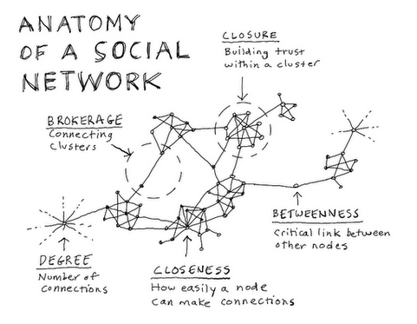
Degree of a network
A degree represents the number of links or neighbors each node(vertices) has
There tends to be a huge range of degrees across any network

Slide 16
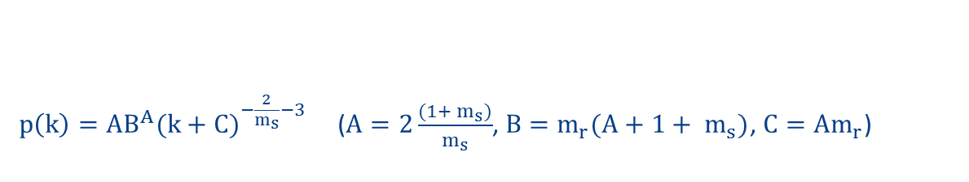
Degree Distribution Obtained in Ideal Model: $p\left(k\right)=AB^{A}{(k+C)}^{−\frac{2}{m_{s}}−3}$ ($A=2\frac{(1+ m_{s})}{m_{s}}$, $B=m_{r}(A+1+ m_{s})$, $C=Am_{r}$)
Vertex degree distribution
Degree Distribution Obtained through simulation:
Here we are finding the number of neighbor(degree) that each node has and comparing it with the total number of degree of the whole network of nodes.
Method
From the random grown network, find the degree of all the vertices.
Find how many vertices has the same number of degrees.
Now divide it with the total number of vertices of the total network
Comparison is made between the ideal model and the algorithm we generated

Slide 17
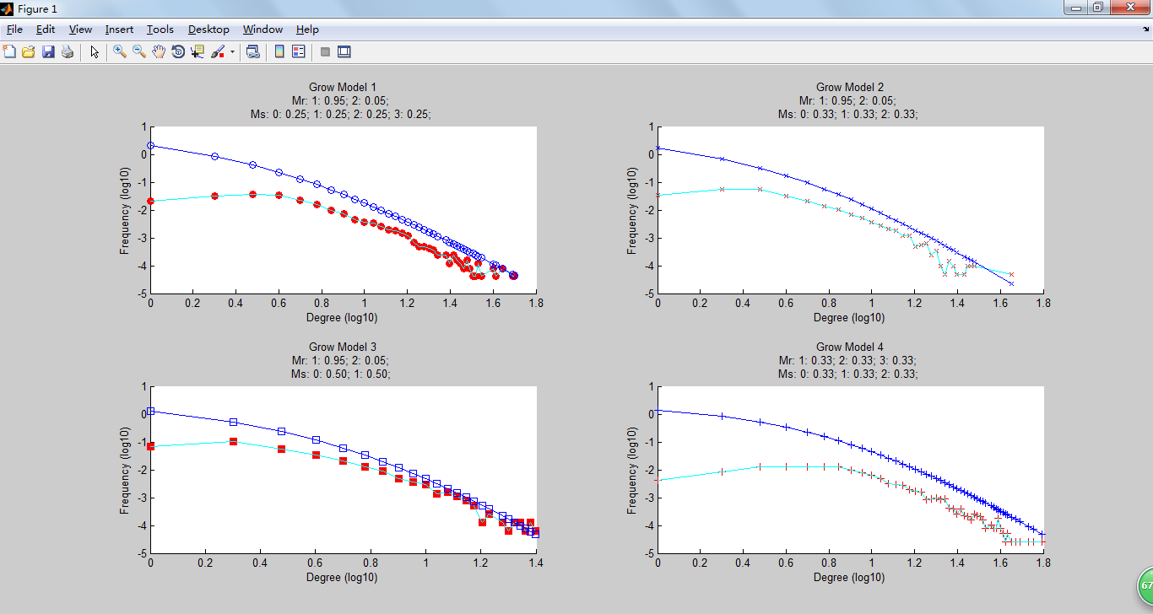
Comparison between simulation model and ideal model
Assuming we have 4 types of network growth with different probabilities of growth

Slide 18
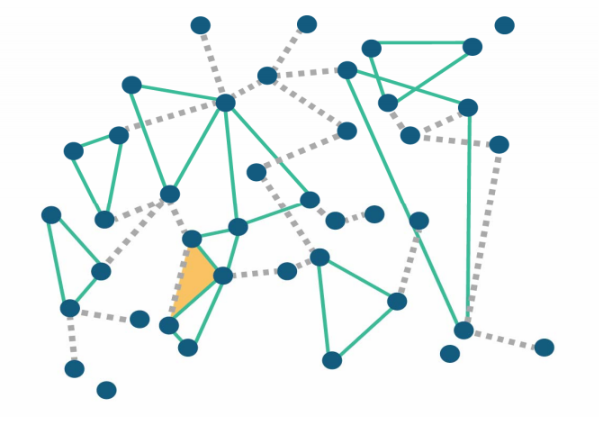
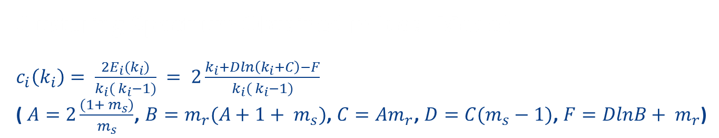
Clustering Spectrum Obtained in Ideal Model: $c_{i}\left(k_{i}\right)= \frac{2E_{i}(k_{i})}{k_{i}( k_{i}−1)} = 2\frac{k_{i}+Dln\left(k_{i}+C\right)−F}{k_{i}( k_{i}−1)}$ ( $A=2\frac{(1+ m_{s})}{m_{s}}$, $B=m_{r}(A+1+ m_{s})$, $C=Am_{r}$, $D=C(m_{s}−1)$, $F=DlnB+ m_{r}$)
Clustering spectrum
Triangles:
Triangles are formed when a vertices has two neighbor and a relationship is formed between those two.

Slide 19
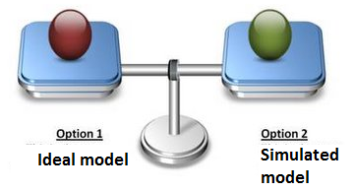
Clustering spectrum through simulation
In the full grown network calculate the real number of triangles formed for each vertices (calculate now many of a node’s neighbor has relationship between themselves)
Divide the real number of triangles with the potential maximum number of triangles that can possibly form
Comparison is made between the ideal algorithm model with the algorithm we simulated and accuracy of the algorithm is calculated.

Slide 20
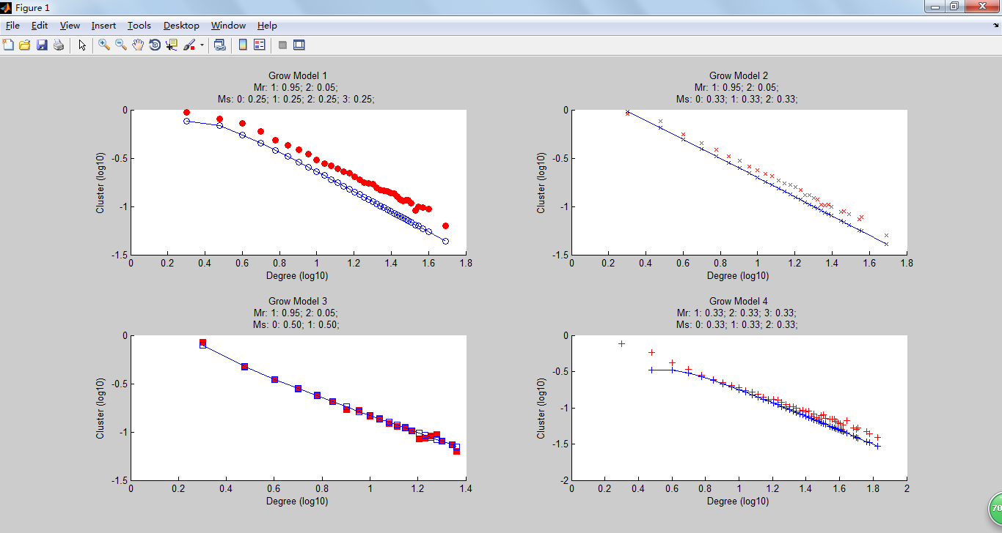
Comparing the clustering spectrum of simulated model with ideal model

Slide 21
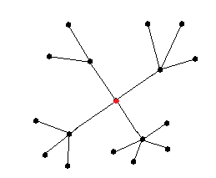





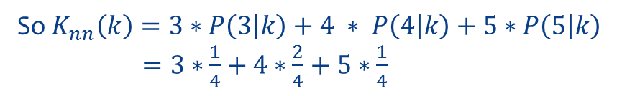
Average Nearest-Neighbor Degree (Knn)
Nearest neighbor degree can be useful to weight the contributions of the neighbors, so that the nearer neighbors contribute more to the average than the more distant ones
Average nearest neighbor degree is calculated based on the following equation
$$K_{nn}\left(k\right)= \sum_{k^{′}}{k^{′}P(k^{′}|k)}$$
$$For the red point, k of which is 4:$$
$$P\left(3 | k\right)=1/4$$
$$P\left(4 | k\right)=2/4$$
$$P\left(5 | k\right)=1/4$$
So $K_{nn}\left(k\right)=3∗P\left(3 | k\right)+4 ∗ P\left(4 | k\right)+5∗P\left(5 | k\right)$
$=3∗\frac{1}{4}$ $+$ $4∗\frac{2}{4}$ $+$ $5∗\frac{1}{4}$

Slide 22
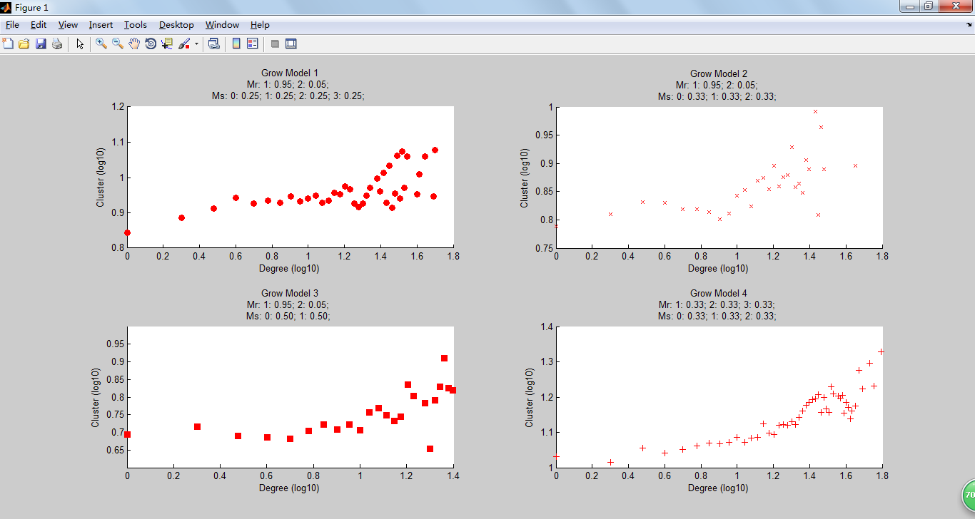
Average Nearest-Neighbor Degree for all the possibilities of network growth

Slide 23
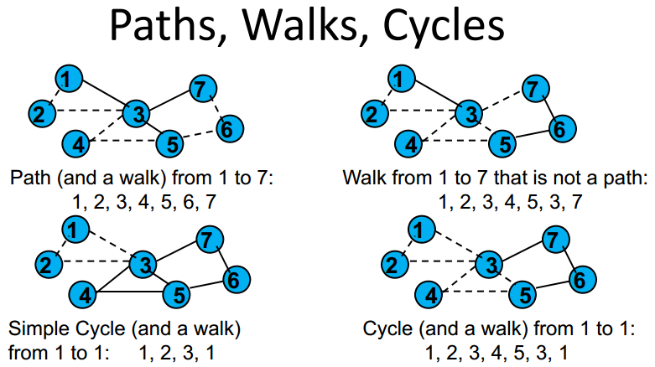
Average Shortest Path
A path in a network is nothing but a walk from with each node being distinct.
The length of a path will be K-1 the links involved
Shortest path is path to take that has the shortest the number of vertices to reach the target node

Slide 24
To Calculate The Average Shortest Path Lengths: Call function “sparse” on the vertices connection matrix Call function “graphshortestpath” to calculate the shortest path between each 2 points of the vertices Sum all the values of the shortest path and divide it by “n*(n-1)/2” (where n is the number of vertices)
Average Shortest Path Lengths

Slide 25
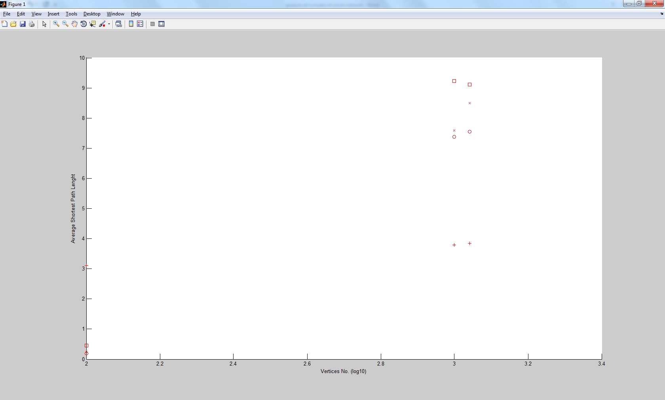
Average Shortest Path Lengths
Plot between the Average shortest path and degree of vertices

Slide 26
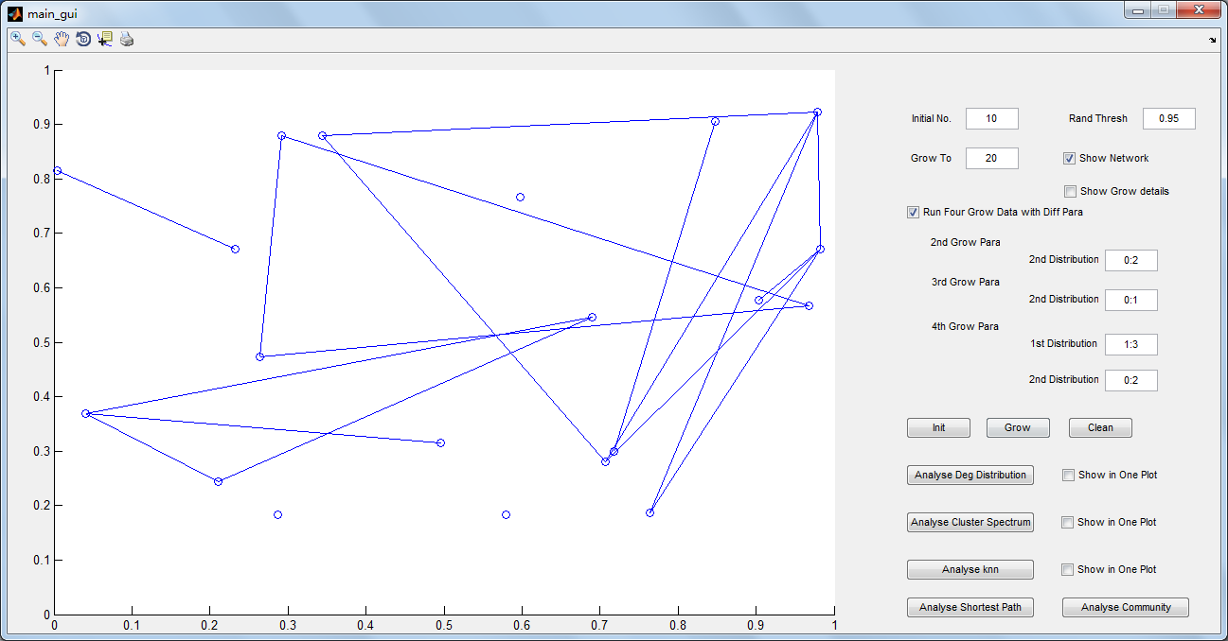
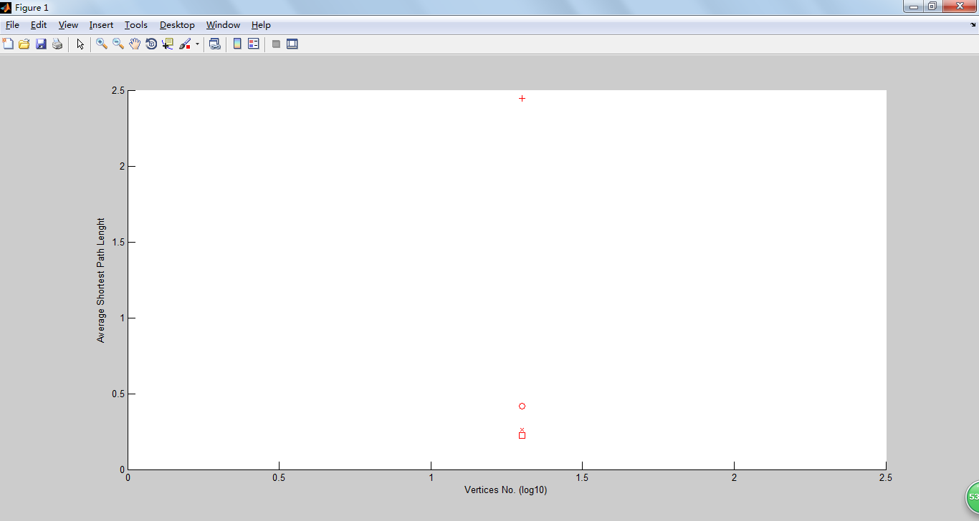
When the network is a small network with only few vertices, average shortest path lengths may be less than 1 because for some points, there is no path to link them
Figure 1 represents fully grown network with 20 nodes
Figure 2 represents the shortest path between every vertices with their respective degree in the network

Slide 27
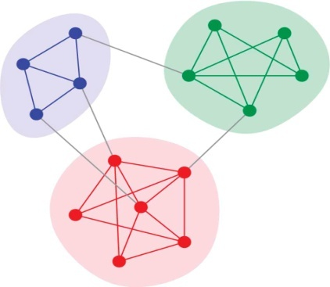
Network Communities
The term network community is defined as a group of nodes that are more densely connected to each other than to other nodes in the network.
K – Clique communities
Uncovering the overlapping community structure of complex networks in nature and society
- G. Palla

Slide 28
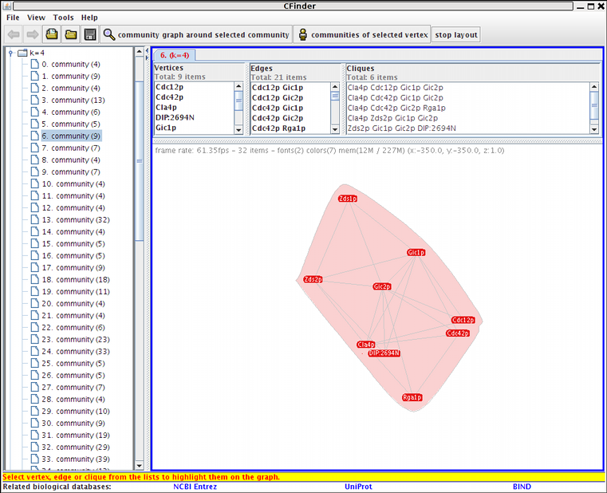
Steps to Obtained The Average Number of k-clique-communities: Use MatLab to get all the links of our random network and write it to a text file Use C-Finder load the text file into it and calculate the size and the number of communities Use Python script to collect the result of C-Finder and plot the it on the figure
Average Number of k-clique-communities

Slide 29
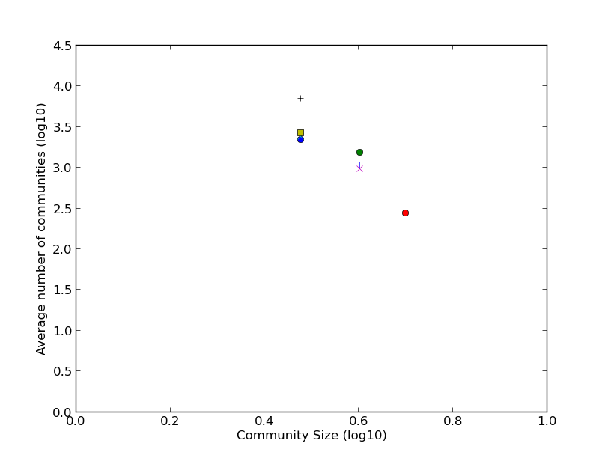
Average Number of k-clique-communities

Slide 30
Recap
Initialize a network specifying the number of nodes and vertices
Grow the network up to a certain limit
Find the degree of the network and compare it with the ideal model
Find the number of clusters (triangles) formed in this network
Find the k- nearest neighbours for all possibilities of network growth
Find the average shortest path length of the network
Find the average number of k-clique communities.

Slide 31

Any Questions?

